Slide 1
Circuits
Pls don’t run away I promise fyzeeks isn’t that hard

Slide 2
Outline of da course
Day 1: Circuits!
Day 2: Work/energy
Day 3: Momentum/gyroscopes
Day 4: Planetary motion
Day 5: Muzik
Day 6: Simple machines
Day 7: TBD
Day 8: Modern Fyzeeks

Slide 3
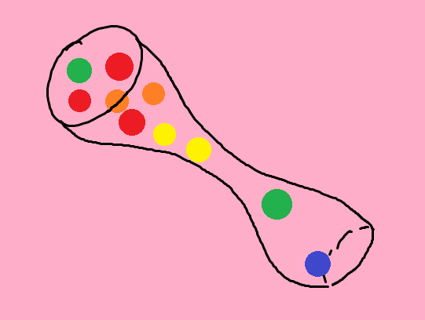
Circuits oversimplified
The more vertical we make the tube, the faster balls fall down through the tube.
We can measure the number of balls that pass through the tube per second.
The thin part of the tube slows down the balls.

Slide 4
Now replace “balls” with electrons
The more vertical we make the tube, the faster balls fall down through the tube.
We can measure the number of balls that pass through the tube per second.
The thin part of the tube slows down the balls.
Voltage: the higher the voltage, the faster electrons move through a circuit.
Current: the number of electrons that pass through the circuit per second.
Resistance: objects with resistance slow down the electrons

Slide 5
Voltage

Slide 6
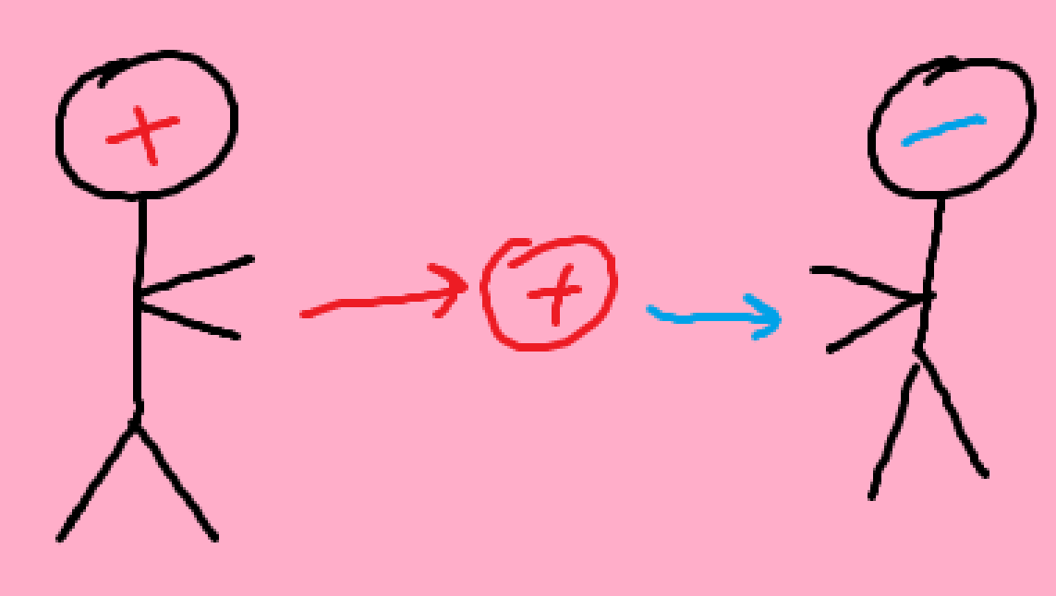
Electric potential
High potential objects have the “potential” to push positive charges to low potential objects.
The greater the difference in potential means the charges get pushed faster.

Slide 7
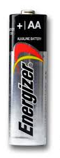
Voltage!
<- High potential
Voltage is the difference in potentials (the bigger it is, the faster charges get pushed)
<- Low potential

Slide 8
Current

Slide 9

Current
Charge over time
How many electrons pass through the wire per second?

Slide 10
Resistance

Slide 11

Resistance
Slows down the movement of electrons.
Now, what affects resistance?

Slide 12
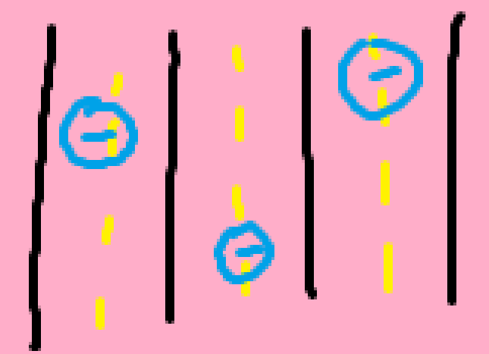
What affects resistance?
Think of a wire as a highway for electrons
Think of ways highway design could affect travel speeds.

Slide 13
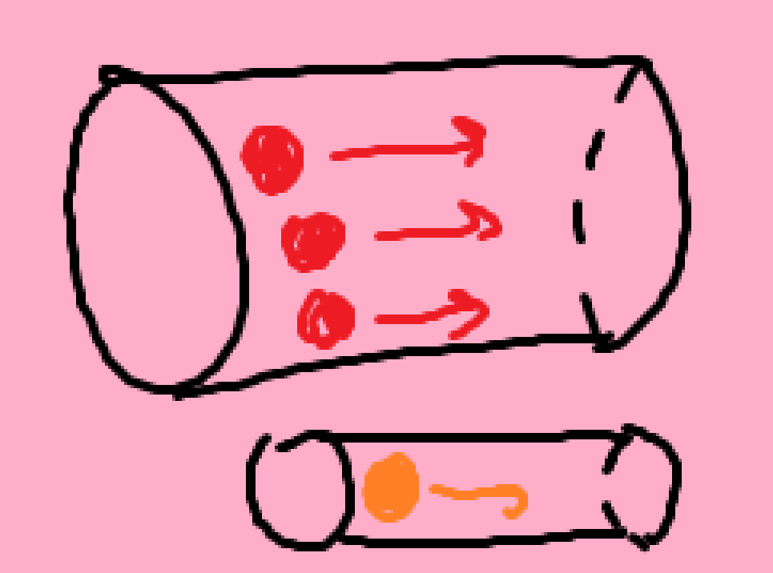
Cross sectional area/how wide the wire is
The thiccer the wire, the more space electrons have to move.
Resistance is smaller for wider objects.

Slide 14

Length of wire
Longer wires can hold more electrons.
You’re more likely to bump into other electrons in longer wires.
“Bumping” slows down movement.
Longer wires have more resistance.

Slide 15
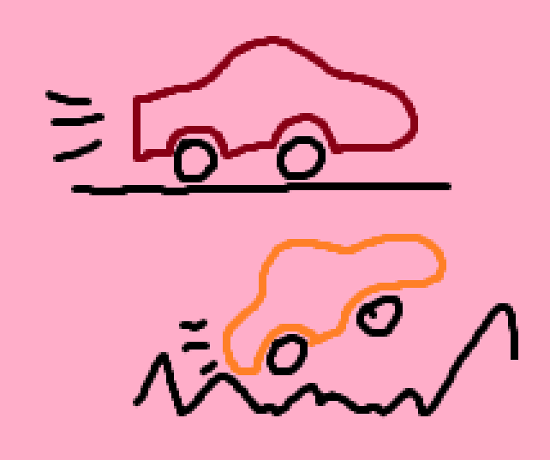
Type of wire
Some roads are just hard to travel on.
We call how hard it is to travel through a wire “resistivity.”

Slide 16
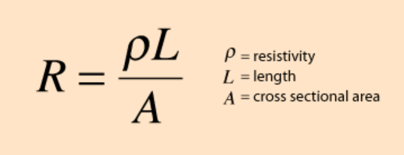
Resistance (lots of word :( scary!)
Resistivity: how much an object “resists” current
Length: uhh, just the length of the wire/object
Area: how thicc the object is (a hair has a very smol cross sectional area while a straw has a larger cross sectional area)

Slide 17
Review
What is voltage?
What is current?
What affects resistance?

Slide 18
Putting it all together

Slide 19
Symbols
Voltage (V) measured in Volts
Current (I) measured in Amps
Resistance (R) measured in Ohms
Does anyone have any guesses why current is I, not C?

Slide 20
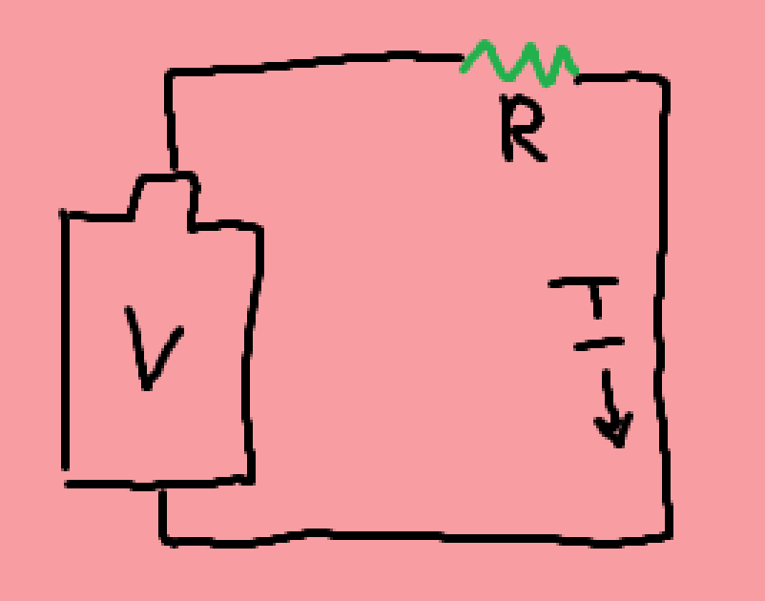
How V, I, and R work
A battery provides us a voltage to drive electrons to move. Resistors and light bulbs (which also have resistances) slow down the electrons. The speed of the electrons is current.

Slide 21
Safety with circuits
Passing high currents through your body will stop your heart.
As such, we should find a way to calculate current.

Slide 22
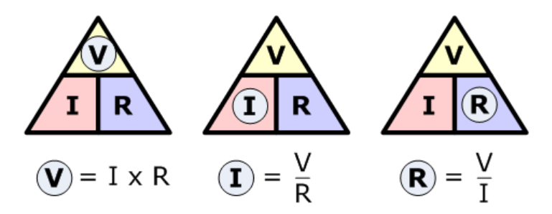
Ohm’s law

Slide 23
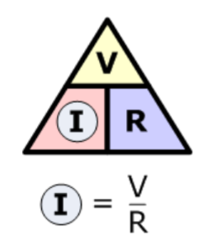
Intuitive sense
If we increase voltage, the electrons want to move faster, so I increases.
If we increase resistance, the electrons want to move slower, so I decreases.

Slide 24
Power

Slide 25

What is power?
Energy transferred over time, or the amount of “work” a circuit does over time.
The more power we provide to a bulb, the brighter it will shine.

Slide 26
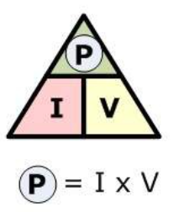
What affects power?
Voltage tells us how much our circuit is “pushing” electrons; basically, it’s a measure of energy we’re giving to the electrons.
Current tells us how many electrons we’re “pushing” per second; this gives us the “over time” part from power.

Slide 27
Review
What are the symbols for voltage, current, and resistance?
What is power?

Slide 28
Real world!

Slide 29
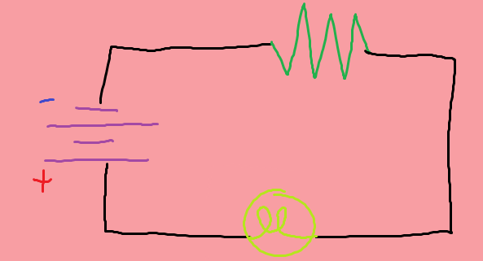
Drawing! That’s fun right?
Purple: battery
Green: resistor
Lime: light bulb
Black: wire

Slide 30

Sample problem
A taser provides 50,000 volts across my arm, which has a resistance of 10,000 ohms. How many amps is the current that passes through my arm?

